Slide 1

Estimating the effect of Internet usage on Scientific and Technological Publications
Group Members:
Anushka Pandhare
Eric Wang
Mitali Bharali
Tapas Mahanta
Paridhi Nath

Slide 2
Workflow Process
Abstract
Global Statistics
Data Exploration
Modelling
Conclusion

Slide 3
ABSTRACT
Our research includes data from the world bank database which has country level data for the following Science and Technology Indicators:
High-technology exports (% of manufactured exports)
High-technology exports (current US$)
Technicians in R&D (per million people)
Researchers in R&D (per million people)
Trademark applications, total
Trademark applications, direct resident
Trademark applications, direct nonresident
Patent applications, residents
Patent applications, nonresidents
Scientific and technical journal articles
Research and development expenditure (% of GDP)
Charges for the use of intellectual property, receipts (BoP, current US$)
Charges for the use of intellectual property, payments (BoP, current US$)

Slide 4
ABSTRACT
The idea is to study the effect of internet usage on various indicators from the year 2000 to 2015.
We analyzed the effect of internet usage on scientific and technological publications and also on each individual indicator on country level data, using Fixed Effect Model.
Further, we extended our study to countries of different income groups and compared the results.

Slide 5
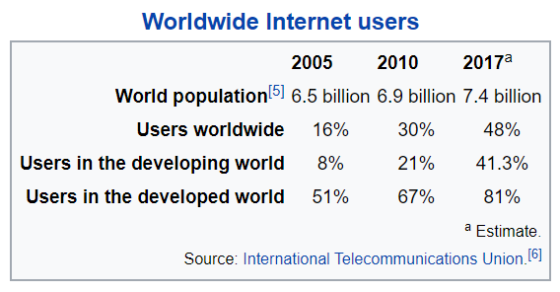
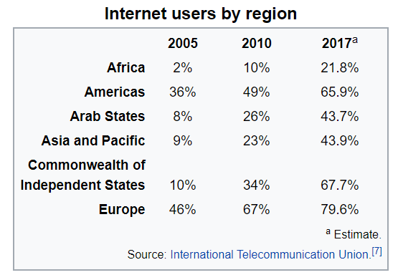
GLOBAL STATISTICS
Internet became mainstream since 80s-90s and now, more than 4.2 billion people around the world use the internet.
Since 2010,there has been a 1,066 percent increase in the number of internet users around the world, and Middle East is the world’s largest growing region in terms of internet use.

Slide 6
Patent applications have been on an upward trajectory since 2003 and grew by 5.8% in 2017. We can relate this increase in the number of patent applications to the growth of internet users.
Over the last 14 years, there has been only one drop-off : application activity decreased by 3.8% due to the financial crisis in 2009.
The number of internet users in Asia has increased from almost 9% to 44% in 12 years which maybe linked to the increase in number of Patent applications by 15.4%

Slide 7
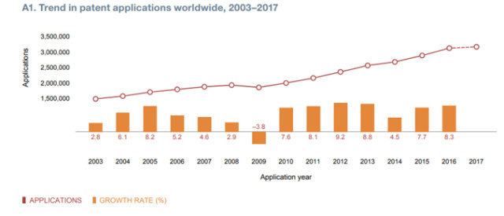
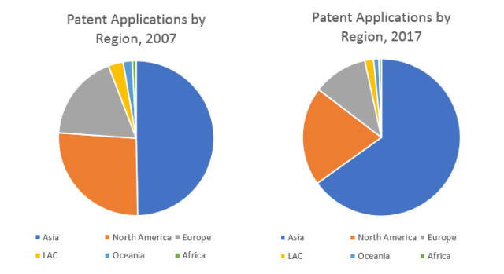

Slide 8
Dataset Exploration
The dataset taken from the World Bank is a panel data containing all the countries which have data for various technological advances. The variables we will be focusing on are –
Countries
Income Group
Patent applications (Residents/Non –Residents)
Trademark Applications (Resident/Non-Resident)
Scientific and Technical Journal Publications

Slide 9
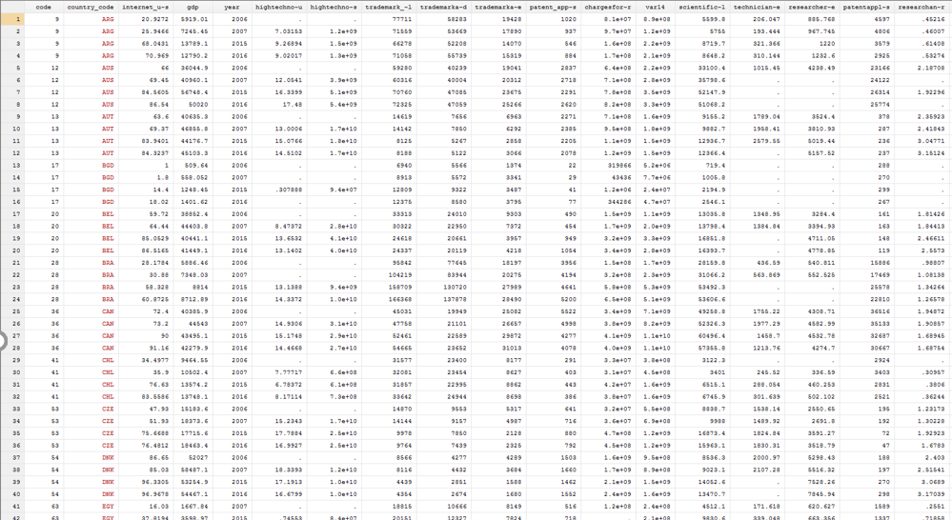
Variables in our Final Dataset
Country
Country Code
Internet Users
GDP
Year
Trademark applications, total
Trademark applications, direct resident
Trademark applications, direct nonresident
Patent applications, residents
Scientific and technical journal articles

Slide 10
Dataset Visualization
We see, Top internet users and bottom most internet users, legend sorted accordingly
Top Countries: Stagnant after 2005
Bottom Countries: Pickup from around 2007, spike for few
The above results were the basis for selecting the time period (2006 & 2016) to study the shock effect.

Slide 11
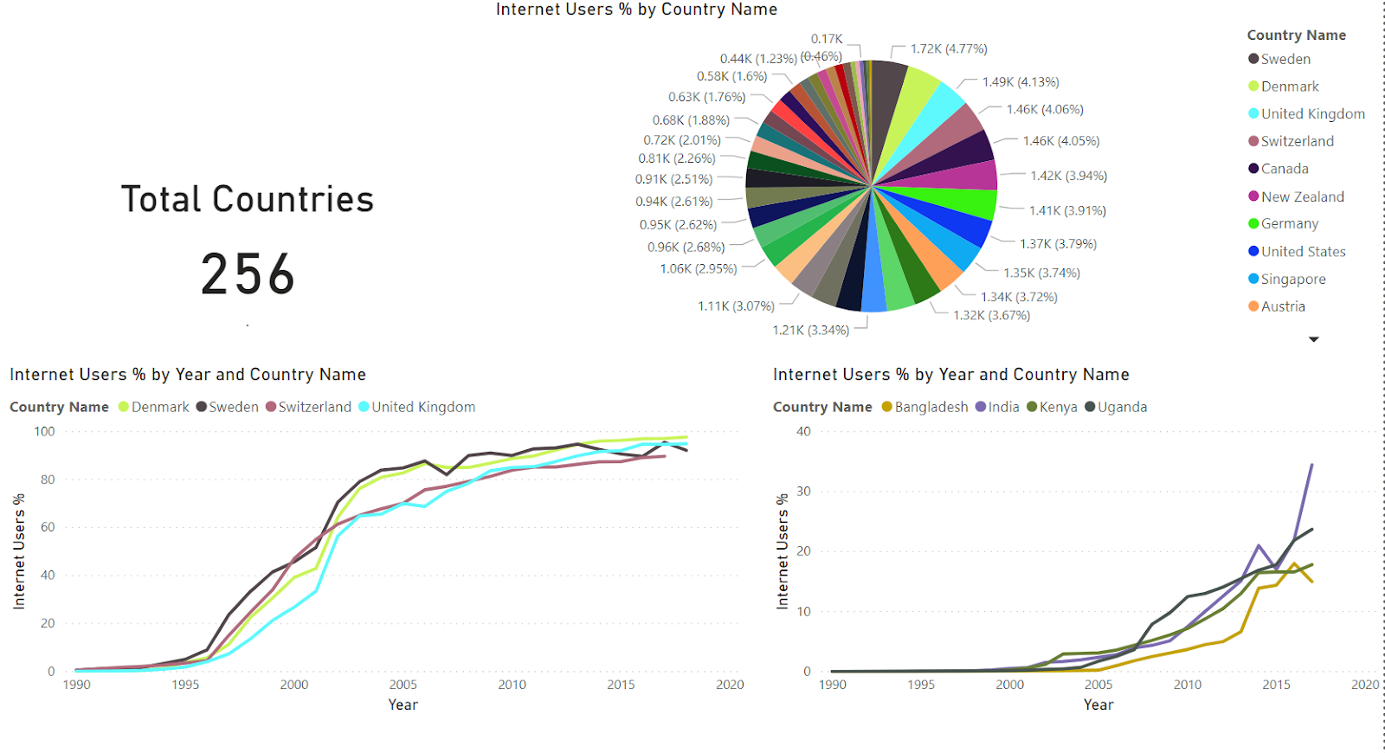

Slide 12
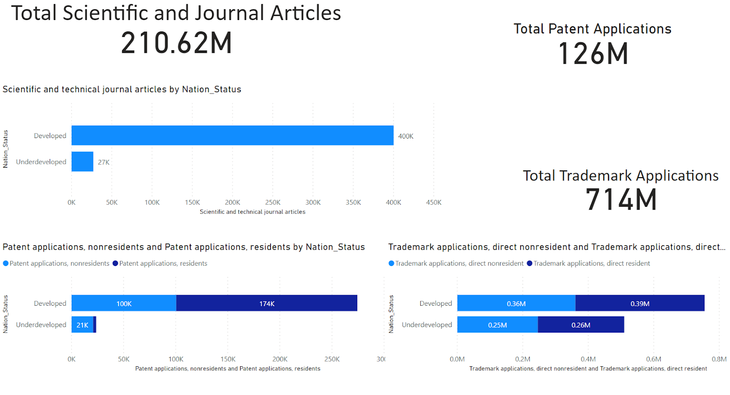
Dataset Visualization
Countries clubbed as Developed and underdeveloped for a comparative analysis
Patent applications nonresident is more than resident for developed while its the opposite for underdeveloped
Trademark applications for residents is more in both developed and underdeveloped

Slide 13
Modelling

Slide 14
Country wise & Income group Regression using Panel data for 2 years
Total number of Patents – For 1% point increase in internet penetration, the number of patents applications increase by 0.7%
Total number of publications – For 1% point increase in internet penetration, total publications decrease by 0.01%
For 1% increase in internet usage, all publications increase by 3% in all income groups.

Slide 15
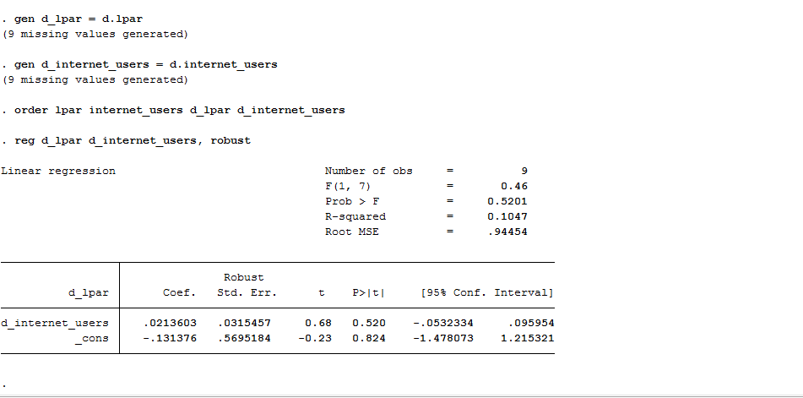
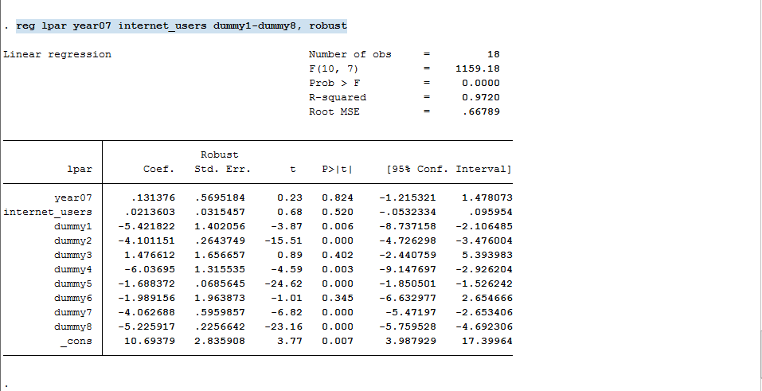
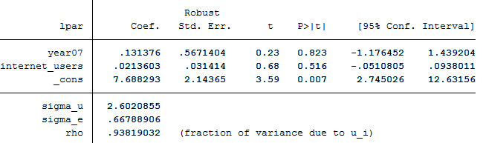
Comparing Fixed Effect, First Difference & Dummy Variable Regression
First Difference
Dummy Variable Regression
Fixed Effect

Slide 16
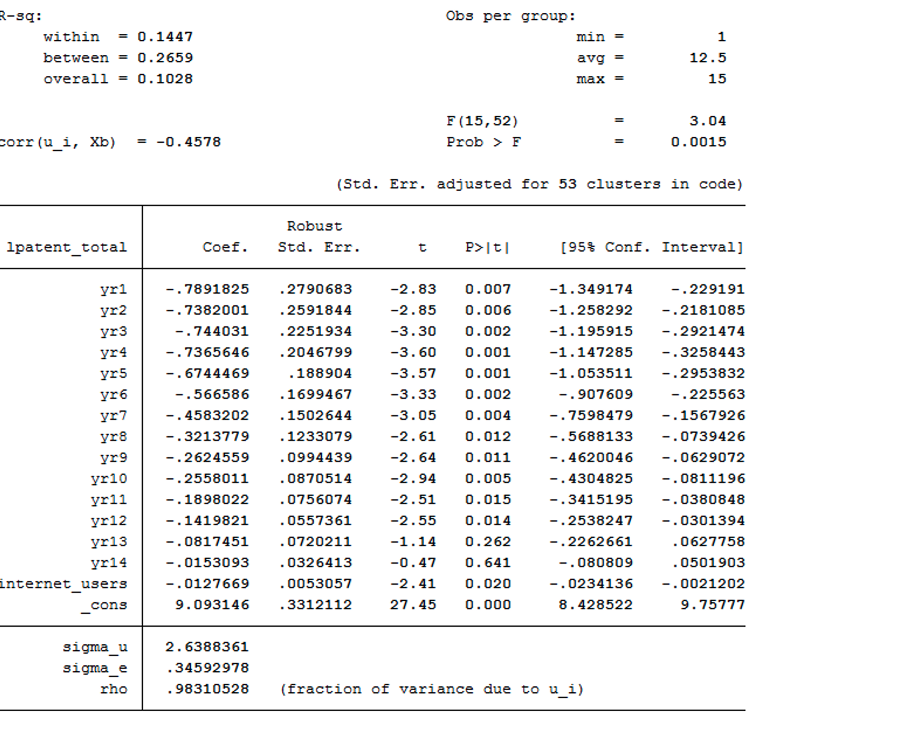
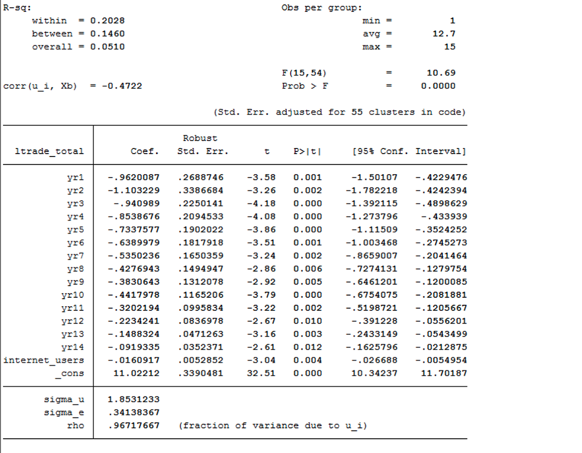
Country wise individual science and technology indicator
Notes:
Patent + trademark

Slide 17
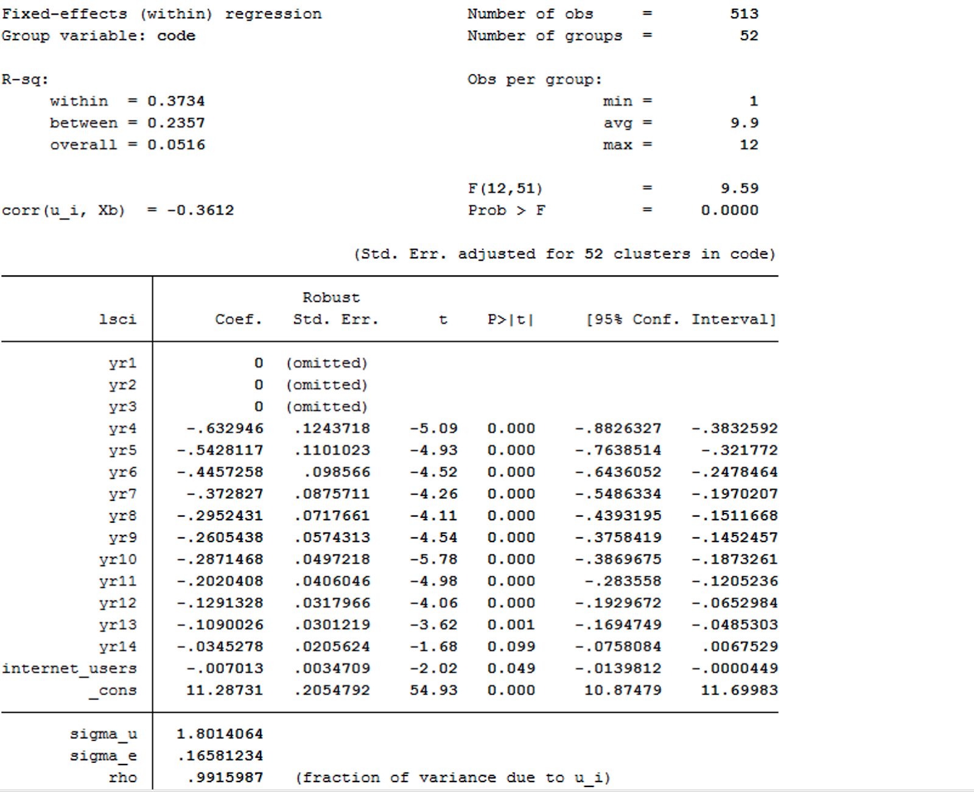
Country wise all science and technology indicators

Slide 18
Income groups individual science and technology indicator

Slide 19
Income groups all science and technology indicators

Slide 20
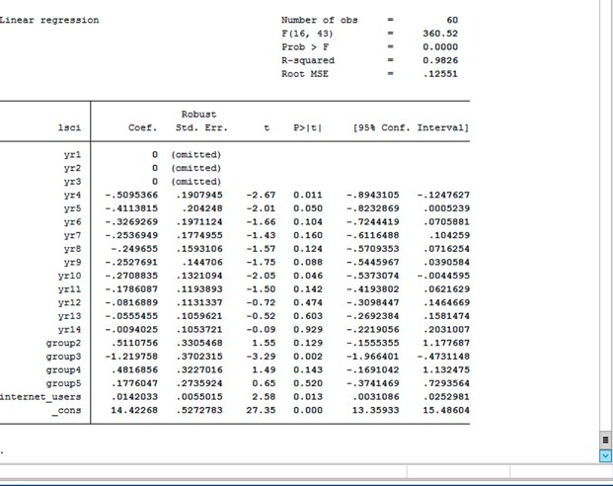
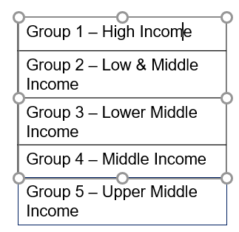
COMPARISON WITHIN INCOME GROUPS

Slide 21
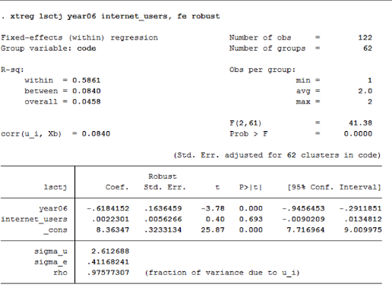
Number of scientific and technology journals year 2006-2016
For every 1% increase in internet penetration , no of science and technology journals increase by 0.2%
From 2006 to 2016 the total number of science and technology journals increased by 61%. Though there’s a huge jump in the total number of science and technology journals, seems like internet penetration had a very little effect on it. Which can also be seen from low R square value and high intercept.

Slide 22
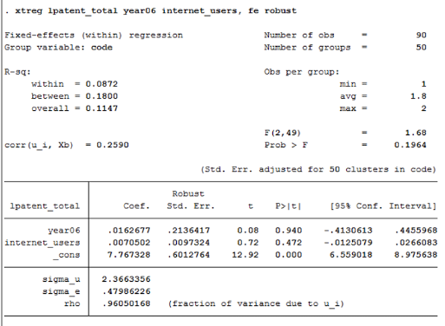
Patent applications total 2006-2015
For every 1% increase in internet penetration , total no of patent applications increase by 0.7%
From 2006 to 2016 the total number of patent applications (non-resident) increased by 1.6%

Slide 23
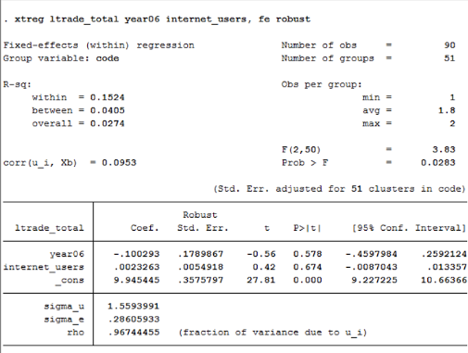
Trademark Applications total year 2006-2016
For every 1% increase in internet penetration , total no trademark applications increases by 0.2%
From 2006 to 2016 the total no trademark applications (by non-resident) increased by 10%

Slide 24
CONCLUSION
When we used panel data for 2 years, total number of patents and trademark applications increased with increase in internet usage
When we used panel data for 15 years from 2000-2015, the total number of trademark and patent applications decrease with increase in internet usage
Compared to high income groups, upper middle & lower middle income groups have a higher increase in the number of scientific publications

Slide 25
THANKS!
Any questions?

